Slide 1

Fifa Finder Application
By Darren Doyle

Slide 2
The Idea
An app to find players to partner with on the popular gaming title Fifa
Write posts that specify that specify your preferences
See other users posts and filter posts by preference
Ability to create a unique account to post from
Potential for an integration with popular gaming platforms if successful

Slide 3
What’s the aim?
Full CRUD functionality with a database
Implementing a frontend with Angular
A thorough requirements and risk analysis for the project
A detailed design plan using the technologies requested
A version control system
Project tracking using agile methodologies
A high level of test code coverage
A CI/CD pipeline which deploys to an app service

Slide 4
Technologies
Kanban Board: Jira
Database: Azure Virtual Machine
Programming languages: C# & Javascript
Front-end: Angular
Version Control: Git
CI Server: Azure DevOps
Cloud server: Azure App Service

Slide 5
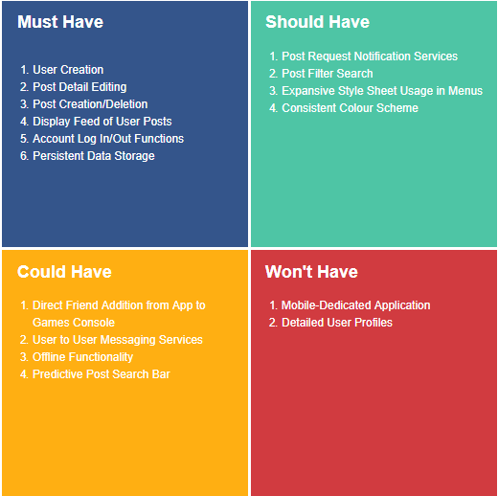
Requirements

Slide 6
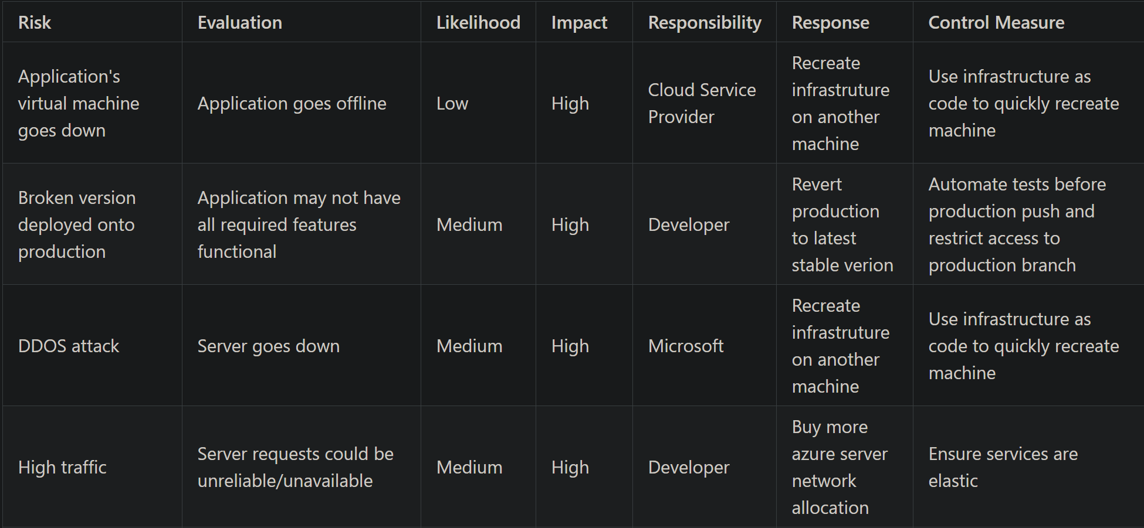
Risk Assessment

Slide 7
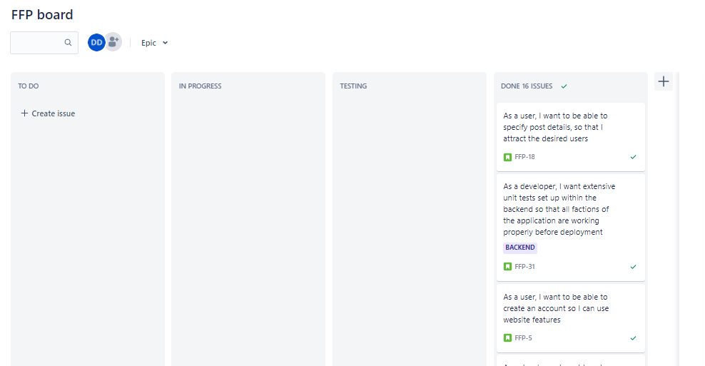
Project Tracking

Slide 8
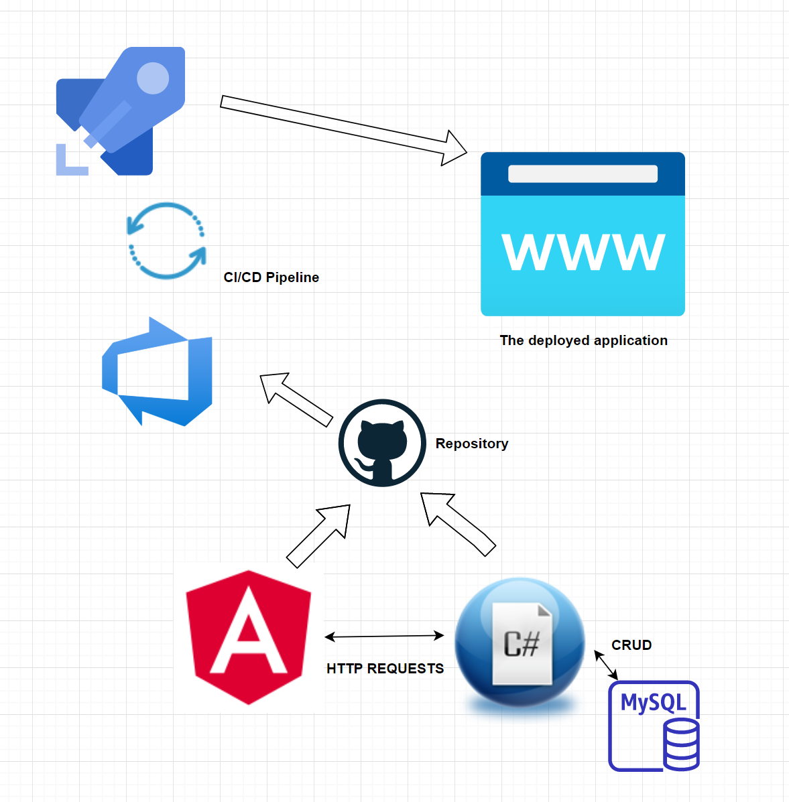
Design

Slide 9
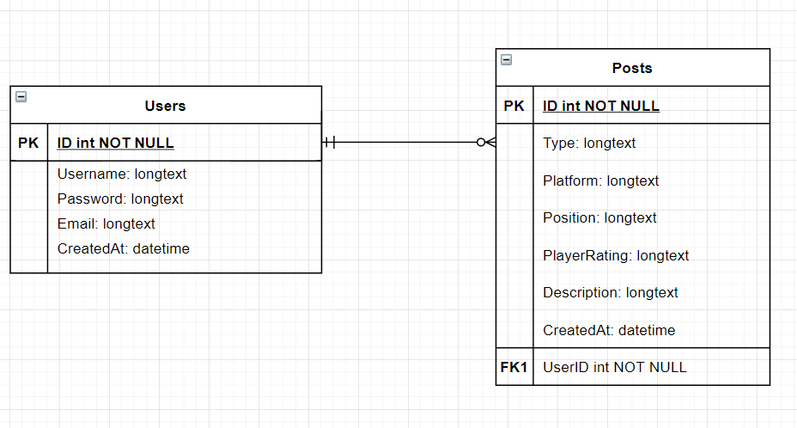
Database Structure

Slide 10
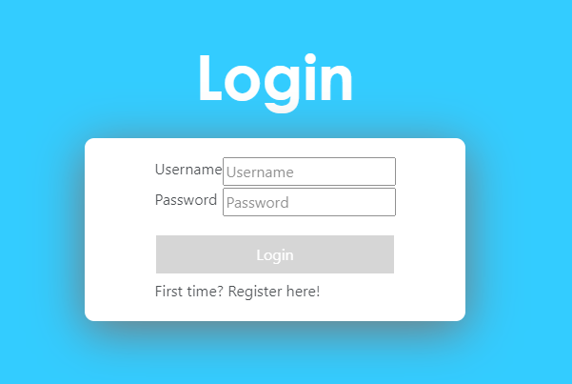
Frontend: Logging in

Slide 11
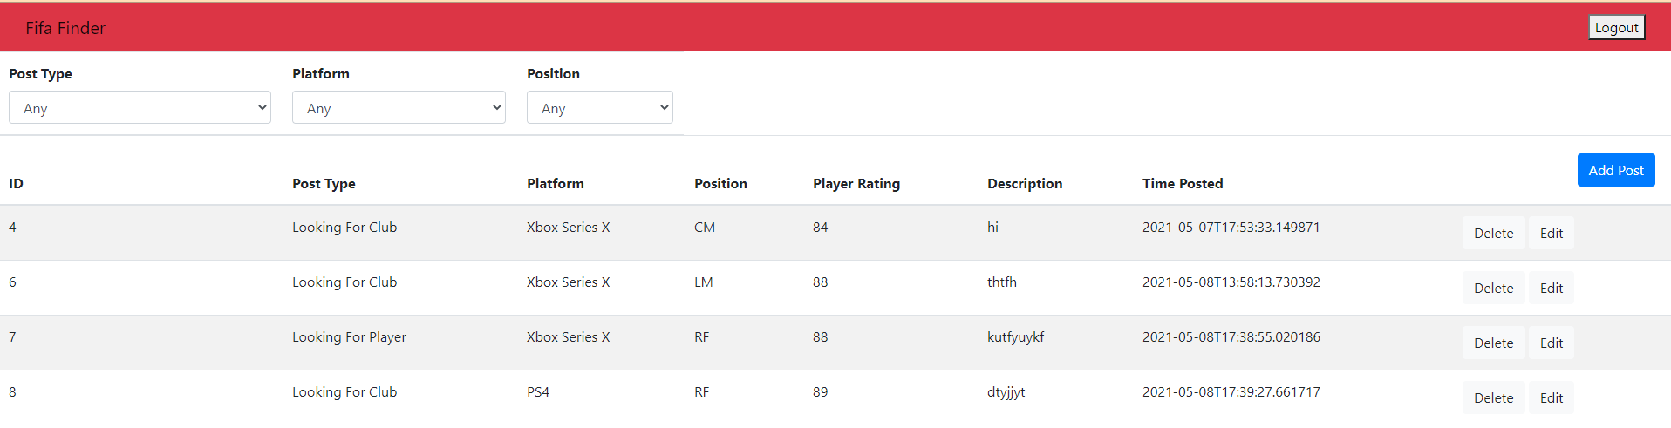
Frontend: Post Hub

Slide 12
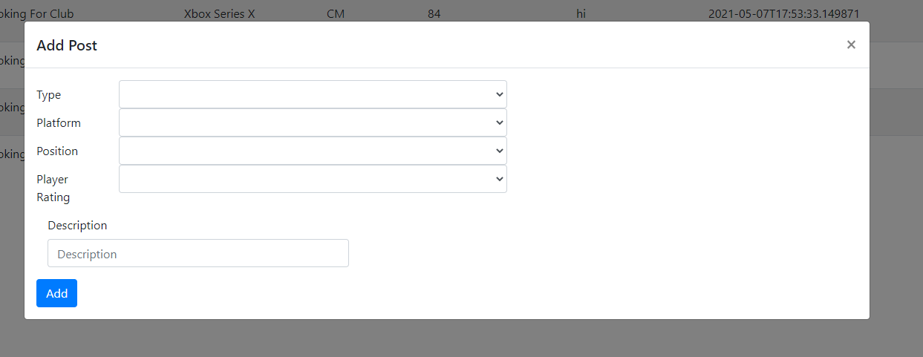
Frontend: Post Creation

Slide 13
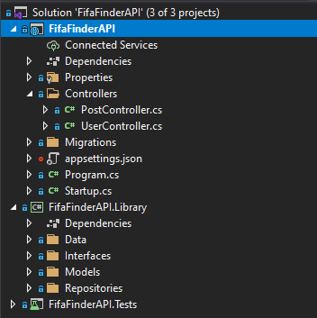
Frontend
API Project
Class Library
Xunit Test Project
User Controller
Post Controller

Slide 14
Controllers
Talks to the frontend
Handle incoming requests made for CRUD functions
Logic written which protects data integrity
Uses clever modelling to structure data received for MYSQL

Slide 15
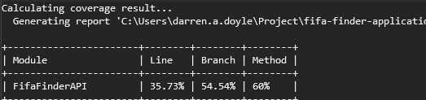
Testing
Controller CRUD methods tested in multiple scenarios
Asserting results have appropriate return types and are not null
Repository pattern in controllers to aid with database context recreation

Slide 16
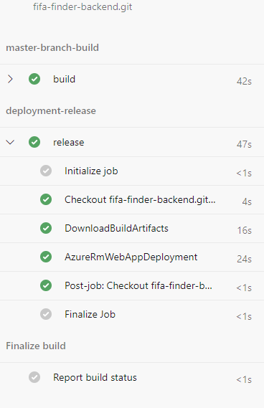
CI/CD Pipeline & Deployment
Azure virtual machine acting as hosting agent for the pipeline
Scripts ran on backend successfully, deploying to the azure app service
Frontend deployment scripts did not pass build phase

Slide 17
What went well
Angular to ASP communication
Crud functionality worked like a charm within angular components
Angular route controls and login system
Data modelling worked as intended
Requirement analysis helped at crunch time!

Slide 18
What went not so well
The deployment of separate angular and asp projects proved challenging
Could not parse user id foreign keys from the user object (frontend)
Repository patterns for controllers
Time management

Slide 19
Thank you!

